Slide 1
B-2 – Final Demo
Kris Burney
Kyle fiSCher
Khoi cao

Slide 2

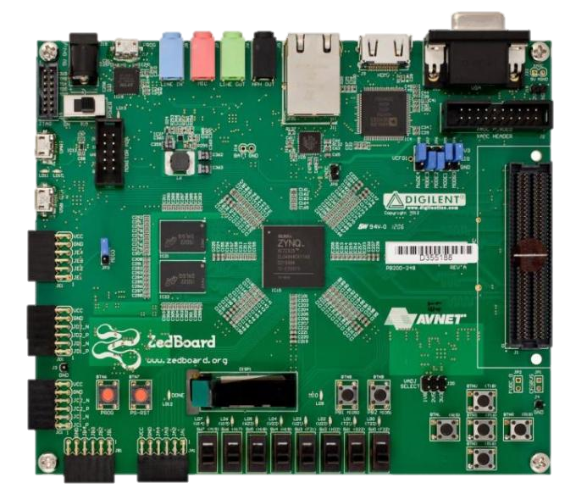
Big Picture
Detect the position of a specific sound source
Source could be a beep or a human voice

Slide 3
Challenges
Documentation on Pmics were misleading
Frequency & Amplitude out of box
Spi
Implemented with Digilent Pmic vhdl module + axi user_logic
Implemented with Spi module
Sampling rate
Interrupts
No one knew exactly how to use them
Now we know more about it than we ever wanted to

Slide 4
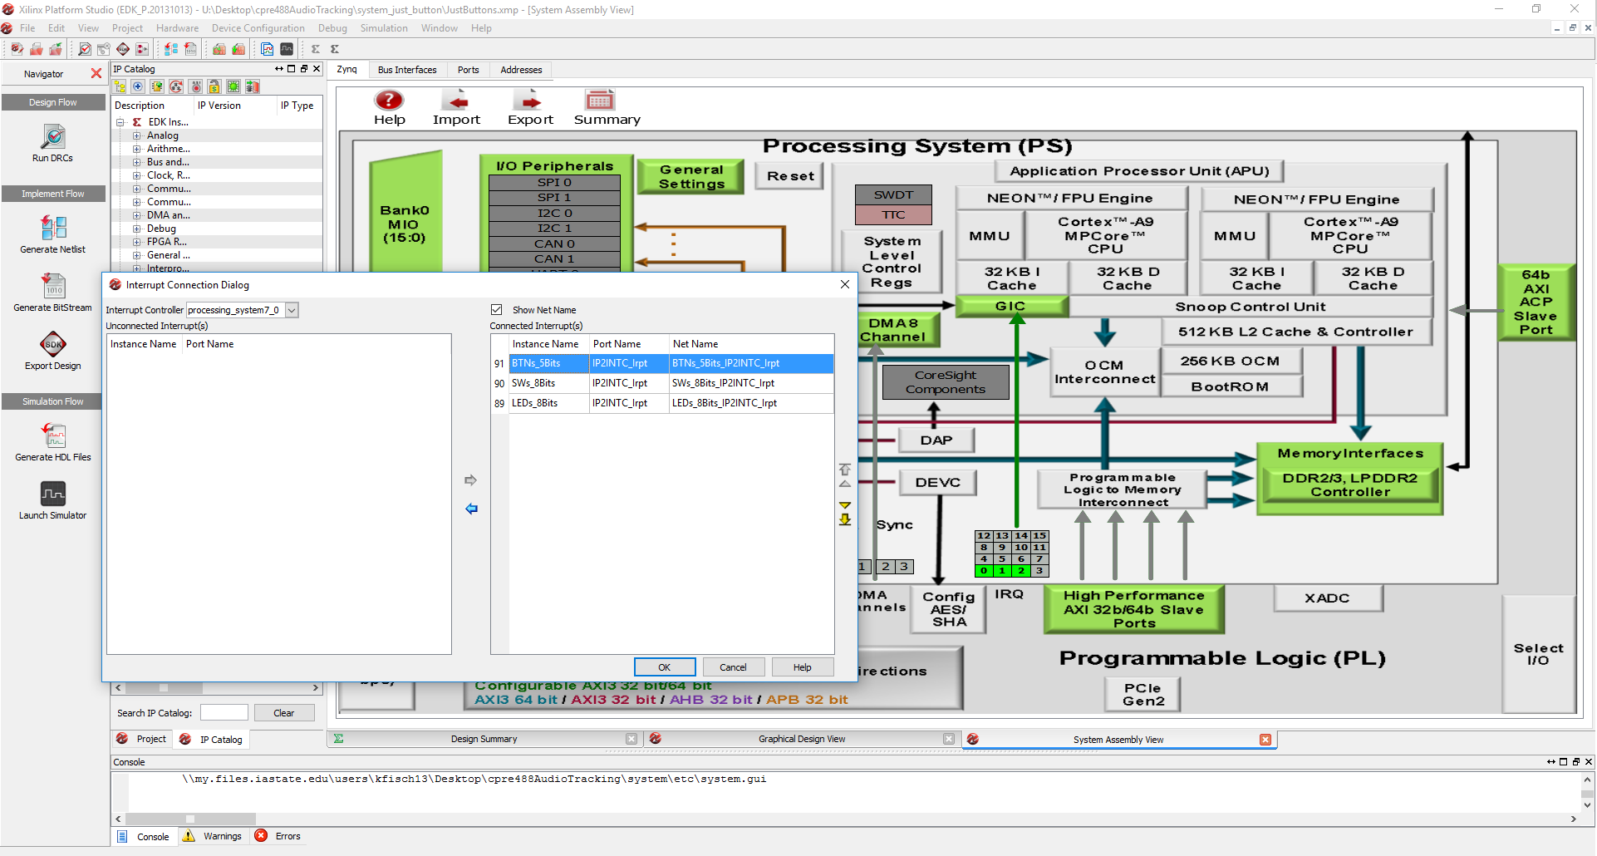
Interrupts

Slide 5
Results
Videos

Slide 6
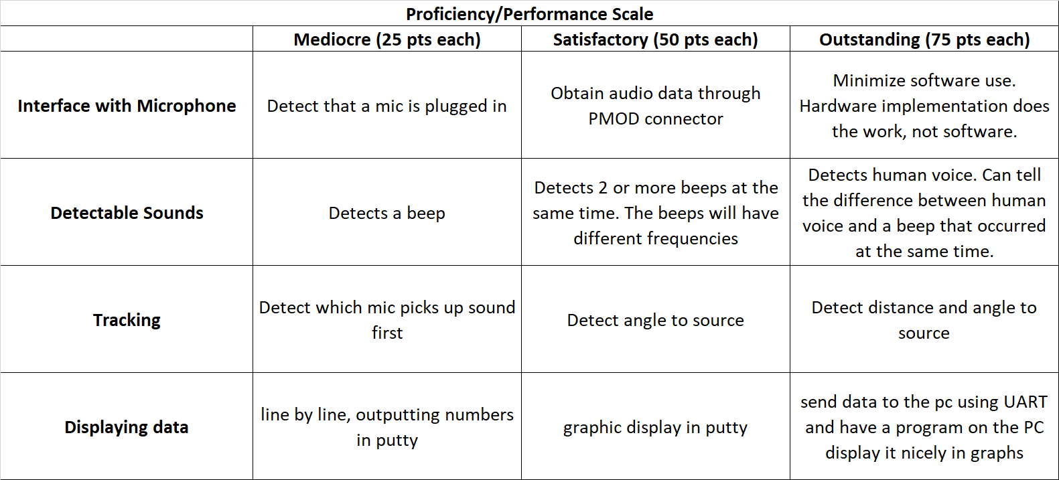
Results

